Slide 1
Recurrent Neural Network : Basic
Juhee Lee
Feb 14, 2019

Slide 2
Time series data and Neural Network

Slide 3

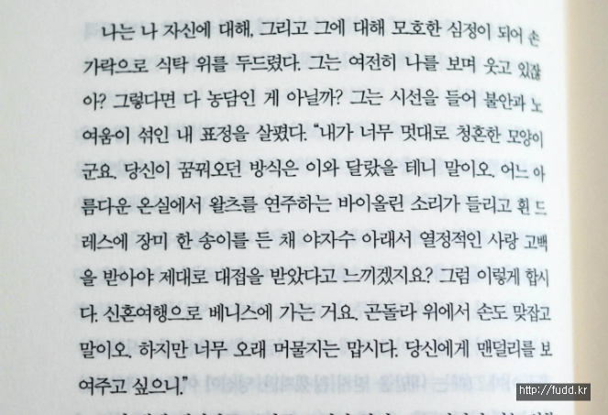
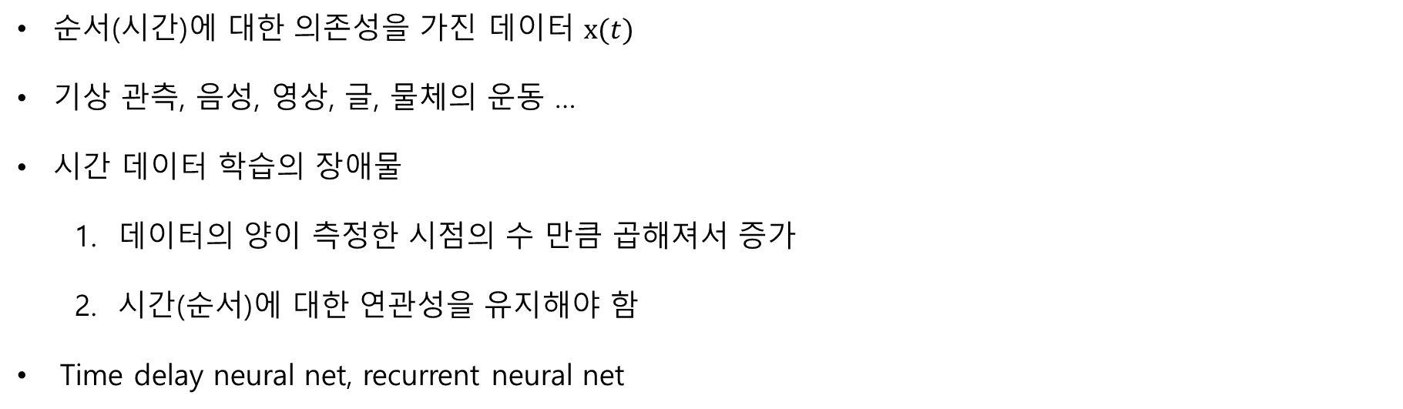
Time series data
순서(시간)에 대한 의존성을 가진 데이터 $x(t)$
기상 관측, 음성, 영상, 글, 물체의 운동 …
시간 데이터 학습의 장애물
데이터의 양이 측정한 시점의 수 만큼 곱해져서 증가
시간(순서)에 대한 연관성을 유지해야 함
Time delay neural net, recurrent neural net

Slide 4








































Multi-Layer Perceptron
$$⋯$$
$$t_{5}$$
$$t_{4}$$
$$t_{3}$$
$$t_{2}$$
$$t_{1}$$
$$ω_{11}^{(1)}$$
$$a_{1}^{(2)}$$
$$a_{1}^{(3)}$$
$$⋯$$
$$a_{1}^{(l)}$$
$$ω_{11}^{(l)}$$
$$t_{1}$$
$$t_{2}$$
$$t_{3}$$
$$t_{4}$$
$$t_{5}$$
$$⋯$$
$$x_{1}$$
$$x_{1}$$
$$x_{1}$$
$$x_{1}$$
$$x_{1}$$
$$x_{1}$$
$${\overline{y}}_{1}$$
$${\overline{y}}_{1}$$
$${\overline{y}}_{1}$$
$${\overline{y}}_{1}$$
$${\overline{y}}_{1}$$
$${\overline{y}}_{1}$$
$$a_{2}^{(2)}$$
$$a_{2}^{(3)}$$
$$⋯$$
$$a_{2}^{(l)}$$
$$x_{2}$$
$$x_{2}$$
$$x_{2}$$
$$x_{2}$$
$$x_{2}$$
$$x_{2}$$
$${\overline{y}}_{2}$$
$${\overline{y}}_{2}$$
$${\overline{y}}_{2}$$
$${\overline{y}}_{2}$$
$${\overline{y}}_{2}$$
$${\overline{y}}_{2}$$
$$⋮$$
$$⋮$$
$$⋮$$
$$⋮$$
$$⋮$$
$$⋮$$
$$⋮$$
$$⋮$$
$$⋮$$
$$⋮$$
$$⋮$$
$$⋮$$
$$⋮$$
$$⋮$$
$$⋮$$
$$⋮$$
$$x_{s(in)}$$
$$x_{s(in)}$$
$$x_{s(in)}$$
$$x_{s(in)}$$
$$x_{s(in)}$$
$$x_{s(in)}$$
$${\overline{y}}_{s(out)}$$
$${\overline{y}}_{s(out)}$$
$${\overline{y}}_{s(out)}$$
$${\overline{y}}_{s(out)}$$
$${\overline{y}}_{s(out)}$$
$${\overline{y}}_{s(out)}$$
$$ω_{s\left(2\right)s(in)}^{(1)}$$
$$a_{s(2)}^{(2)}$$
$$a_{s(3)}^{(3)}$$
$$⋯$$
$$a_{s(l)}^{(l)}$$
$$ω_{s\left(out\right)s(l)}^{(l)}$$
Input layer
Hidden layer
Output layer
(hypothesis)
Notes:
우리가 알고 있는 형태의 neural network
Notation 설명
Input layer: x
Hidden layer: weight, activation value
Output layer: y
Layer의 개수: input을 제외, l+1 layers
Subscript: node index
Superscript: layer index

Slide 5























Time series data on NN
$$x_{1}$$
$$a_{1}^{(2)}$$
$$a_{1}^{(3)}$$
$$a_{1}^{(4)}$$
$${\overline{y}}_{1}$$
$$t_{3}$$
$$⋮$$
$$⋮$$
$$⋮$$
$$a_{s(2)}^{(2)}$$
$$⋮$$
$$⋮$$
$$x_{s(in)}$$
$$a_{s(3)}^{(3)}$$
$$a_{s(4)}^{(4)}$$
$${\overline{y}}_{s(out)}$$
$$x_{1}$$
$$a_{1}^{(2)}$$
$$a_{1}^{(3)}$$
$$⋮$$
$$t_{2}$$
$$⋮$$
$$⋮$$
$$a_{s(2)}^{(2)}$$
$$x_{s(in)}$$
$$a_{s(3)}^{(3)}$$
시간에 따라 다른 weight를 활성화함
깊은 층은 시간이 지난 후에야 계산이 진행됨
Time delay neural net (TDNN)
너무 많은 학습 파라미터
$$a_{1}^{(2)}$$
$$x_{1}$$
$$⋮$$
$$t_{1}$$
$$⋮$$
$$a_{s(2)}^{(2)}$$
$$x_{s(in)}$$

Slide 6

















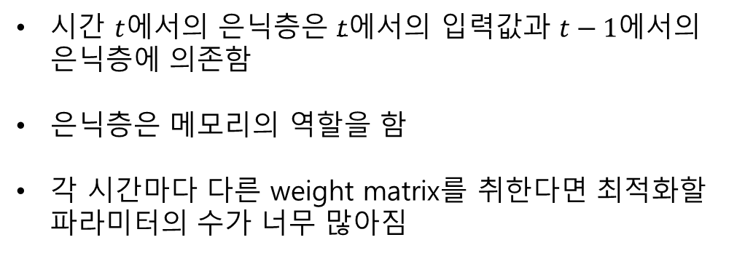









Time series data on NN
$$t_{3}$$
$$u_{11}^{(t_{3})}$$
$$v_{11}^{(t_{3})}$$
$$x_{1}$$
$$a_{1}^{(4,t_{3})}$$
$${\overline{y}}_{1}$$
$$⋮$$
$$⋮$$
$$⋮$$
$$x_{s(in)}$$
$$a_{s(t_{3})}^{(t_{3})}$$
$${\overline{y}}_{s(out)}$$
$$t_{2}$$
$$x_{1}$$
$$u_{11}^{(t_{2})}$$
$$a_{1}^{(t_{2})}$$
$$w_{11}^{(t_{3})}$$
$$⋮$$
$$⋮$$
$$x_{s(in)}$$
시간 $t$에서의 은닉층은 $t$에서의 입력값과 $t−1$에서의 은닉층에 의존함
은닉층은 메모리의 역할을 함
각 시간마다 다른 weight matrix를 취한다면 최적화할 파라미터의 수가 너무 많아짐
$$a_{s(t_{2})}^{(t_{2})}$$
$$t_{1}$$
$$u_{11}^{(t_{1})}$$
$$x_{1}$$
$$a_{1}^{(t_{1})}$$
$$w_{11}^{(t_{2})}$$
$$⋮$$
$$⋮$$
$$x_{s(in)}$$
$$a_{s(t_{1})}^{(t_{1})}$$

Slide 7



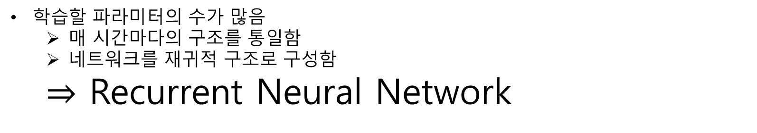



Time series data on NN
학습할 파라미터의 수가 많음
매 시간마다의 구조를 통일함
네트워크를 재귀적 구조로 구성함
$⇒$ Recurrent Neural Network
$$W$$
$$x(t)$$
$$U$$
$$h(t)$$
$$V$$
$$y(t)$$

Slide 8
Recurrent Neural Network

Slide 9
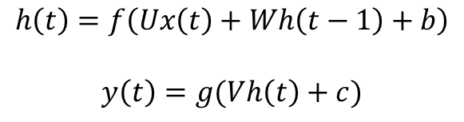



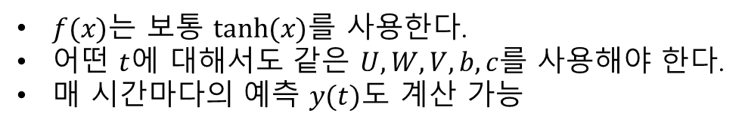
Recurrent neural network(RNN)
$$W$$
$$x(t)$$
$$U$$
$$h(t)$$
$$V$$
$$y(t)$$
$$h\left(t\right)=f\left(Ux\left(t\right)+Wh\left(t−1\right)+b\right)$$
$$y\left(t\right)=g(Vh\left(t\right)+c)$$
$f(x)$는 보통 $tanh⁡(x)$를 사용한다.
어떤 $t$에 대해서도 같은 $U, W, V, b, c$를 사용해야 한다.
매 시간마다의 예측 $y(t)$도 계산 가능

Slide 10





















Unrolling
$$x(t)$$
$$y(t)$$
$$h(t)$$
$$U$$
$$V$$
$$W$$
$$W$$
$$x(t−1)$$
$$h(t−1)$$
$$y(t−1)$$
$$x(t)$$
$$U$$
$$h(t)$$
$$V$$
$$y(t)$$
$$=$$
$$U$$
$$V$$
$$W$$
$$x(t−2)$$
$$h(t−2)$$
$$y(t−2)$$
$$U$$
$$V$$

Slide 11






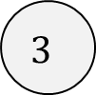









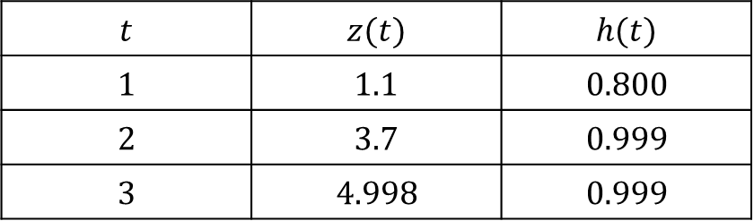






Feedforward
$$x(3)$$
$$y(3)$$
$$h(3)$$
$$3$$
$$U$$
$$V$$
$$U=1, W=2, V=3, b=0.1, c=0.2$$
$$z\left(t\right)=Ux\left(t\right)+Wh\left(t−1\right)+b$$
$$W$$
$$h\left(t\right)=f\left(z\left(t\right)\right) y\left(t\right)=g(Vh\left(t\right)+c)$$
$$x(2)$$
$$h(2)$$
$$2$$
$$U$$
$$f\left(x\right)=tanh, g\left(x\right)=x$$
$$t$$ | $$z(t)$$ | $$h(t)$$
$$1$$ | $$1.1$$ | $$0.800$$
$$2$$ | $$3.7$$ | $$0.999$$
$$3$$ | $$4.998$$ | $$0.999$$
$$W$$
$$x(1)$$
$$h(1)$$
$$1$$
$$U$$
$$W$$
$$y\left(3\right)=3.997$$
$$h(0)$$
$$0$$

Slide 12








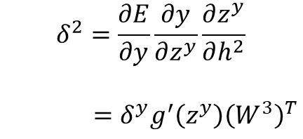






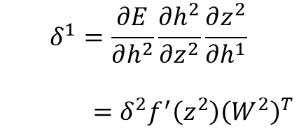











Recall : Backpropagation in DNN
$$δ^{1}=\frac{∂E}{∂h^{1}}$$
$$δ^{2}=\frac{∂E}{∂h^{2}}$$
$$δ^{y}=\frac{∂E}{∂y}$$
$$x$$
$$W^{1}$$
$$h^{1}$$
$$W^{2}$$
$$h^{2}$$
$$W^{3}$$
$$y$$
$$f′(z^{1})$$
$${\left(x\right)}^{T}$$
$$δ^{2}$$
$$f′(z^{2})$$
$${(h^{1})}^{T}$$
$$δ^{y}$$
$$g′(z^{y})$$
$${(h^{2})}^{T}$$
$$δ^{1}$$
$$\frac{∂E}{∂W^{1}}=\frac{∂E}{∂h^{1}}\frac{∂h^{1}}{∂z^{1}}\frac{∂z^{1}}{∂W^{1}}$$
$$\frac{∂E}{∂W^{2}}=\frac{∂E}{∂h^{2}}\frac{∂h^{2}}{∂z^{2}}\frac{∂z^{2}}{∂W^{2}}$$
$$\frac{∂E}{∂W^{3}}=\frac{∂E}{∂y}\frac{∂y}{∂z^{y}}\frac{∂z^{y}}{∂W^{3}}$$
$$\frac{∂E}{∂W^{1}}=δ^{2}f′(z^{1}){(x)}^{T}$$
$$\frac{∂E}{∂W^{2}}=δ^{2}f′(z^{2}){(h^{1})}^{T}$$
$$\frac{∂E}{∂W^{3}}=δ^{y}g′(z^{y}){(h^{2})}^{T}$$
$$δ^{1}=\frac{∂E}{∂h^{2}}\frac{∂h^{2}}{∂z^{2}}\frac{∂z^{2}}{∂h^{1}}$$
$=δ^{2}f^{′}\left(z^{2}\right){\left(W^{2}\right)}^{T}$
$$δ^{2}=\frac{∂E}{∂y}\frac{∂y}{∂z^{y}}\frac{∂z^{y}}{∂h^{2}}$$
$=δ^{y}g^{′}\left(z^{y}\right){\left(W^{3}\right)}^{T}$

Slide 13

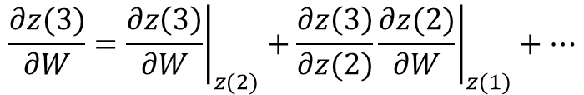














Backpropagation in RNN
$$δ^{3}=\frac{∂E}{∂h(3)}$$
$$δ^{y}=\frac{∂E}{∂y}$$
$$x(3)$$
$$U$$
$$h(3)$$
$$V$$
$$y$$
$$\frac{∂E}{∂V}=\frac{∂E}{∂y}\frac{∂y}{∂z^{y}}\frac{∂z^{y}}{∂V}=δ^{y}g′(z^{y}){h(3)}^{T}$$
$$W$$
$$\frac{∂E}{∂W}=\frac{∂E}{∂h(3)}\frac{∂h(3)}{∂z(3)}\frac{∂z(3)}{∂W}≠δ^{3}f^{′}\left(z^{y}\right){h\left(3\right)}^{T}$$
$$x(2)$$
$$U$$
$$h(2)$$
$$z\left(3\right)=Ux\left(3\right)+Wh\left(2\right)+b$$
$$=Ux\left(3\right)+Wtanh\left(z\left(2\right)\right)+b$$
$$W$$
$$z\left(2\right)=Ux\left(2\right)+Wh\left(1\right)+b$$
$$x(1)$$
$$U$$
$$h(1)$$
시간 $t$에서의 $U, W$에 대한 gradient는 이전 시간의 gradient를 모두 포함해야 함
$$W$$
$$h(0)$$
$$\frac{∂z(3)}{∂W}={\left.\frac{∂z\left(3\right)}{∂W}\right|}_{z(2)}+{\left.\frac{∂z\left(3\right)}{∂z(2)}\frac{∂z(2)}{∂W}\right|}_{z(1)}+⋯$$
$$0$$

Slide 14







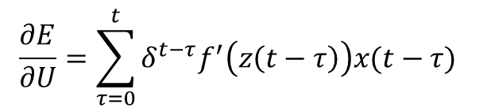


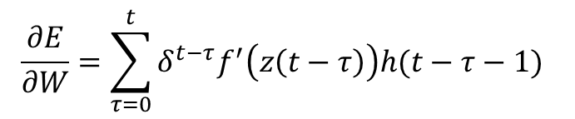
Backpropagation in RNN
$$δ^{3}=\frac{∂E}{∂h(3)}$$
$$δ^{y}=\frac{∂E}{∂y}$$
$$x(3)$$
$$U$$
$$V$$
해결 방법 : 기존의 방법대로 Backpropagation을 하되, 동등한 weight들의 gradient를 모은다!
$$h(3)$$
$$y$$
$$\frac{∂E}{∂W^{3}}=\frac{∂E}{∂h(3)}\frac{∂h(3)}{∂z(3)}\frac{∂z(3)}{∂W^{3}}$$
$$W^{3}$$
$$\frac{∂E}{∂W^{2}}=\frac{∂E}{∂h(2)}\frac{∂h(2)}{∂z(2)}\frac{∂z(2)}{∂W^{2}}$$
$$\frac{∂E}{∂W}=\frac{∂E}{∂W^{3}}+\frac{∂E}{∂W^{2}}+\frac{∂E}{∂W^{1}}$$
$$x(2)$$
$$U$$
$$h(2)$$
$$δ^{2}=\frac{∂E}{∂h(2)}$$
$$\frac{∂E}{∂W^{1}}=\frac{∂E}{∂h(1)}\frac{∂h(1)}{∂z(0)}\frac{∂z(0)}{∂W^{1}}$$
$$W^{2}$$
$$\frac{∂E}{∂W}=\sum_{τ=0}^{t}{δ^{t−τ}f^{′}\left(z\left(t−τ\right)\right)h(t−τ−1) }$$
$$x(1)$$
$$U$$
$$h(1)$$
$$δ^{1}=\frac{∂E}{∂h(1)}$$
$$\frac{∂E}{∂U}=\sum_{τ=0}^{t}{δ^{t−τ}f^{′}\left(z\left(t−τ\right)\right)x(t−τ) }$$
$$W^{1}$$
$$h(0)$$
$$0$$
Backpropagation through time

Slide 15
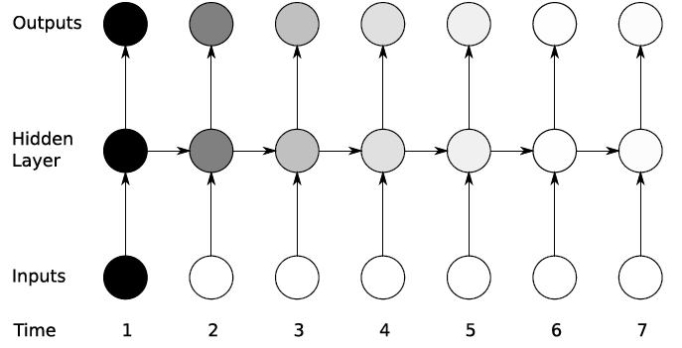
Limit of RNN
Vanishing gradient

Slide 16
Practice : Sin wave

Slide 17
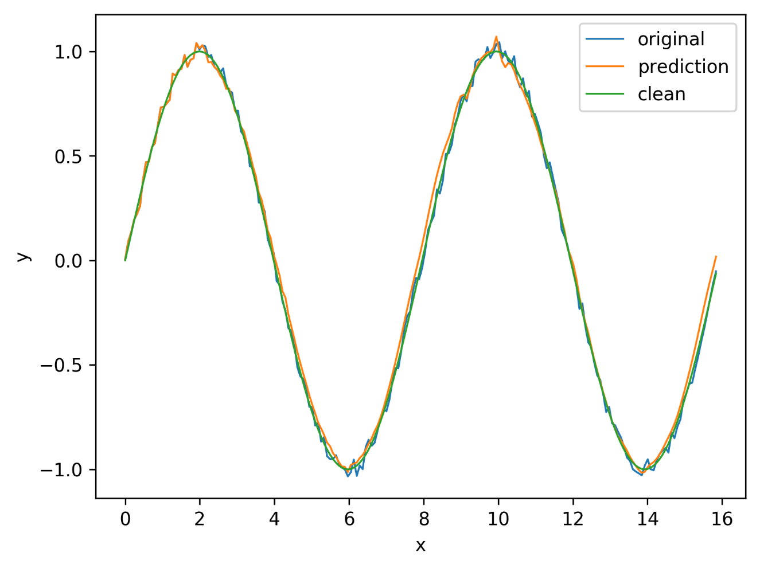
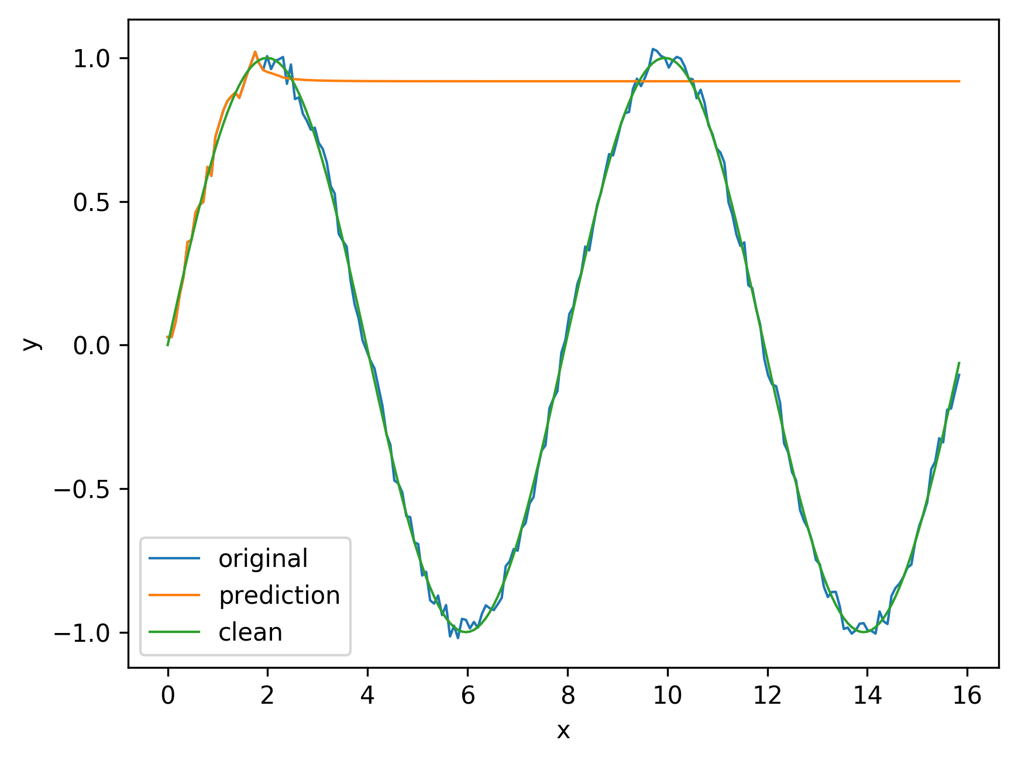
Sine wave prediction

Slide 18
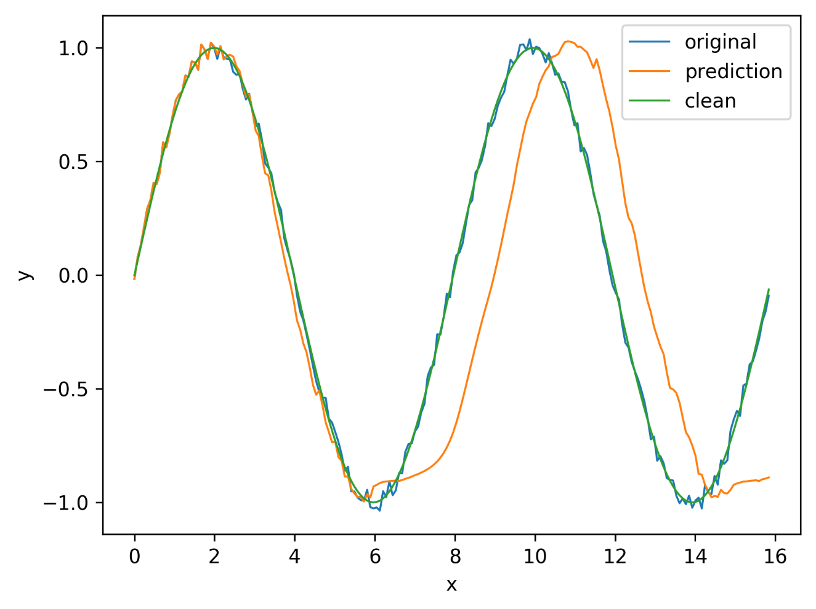
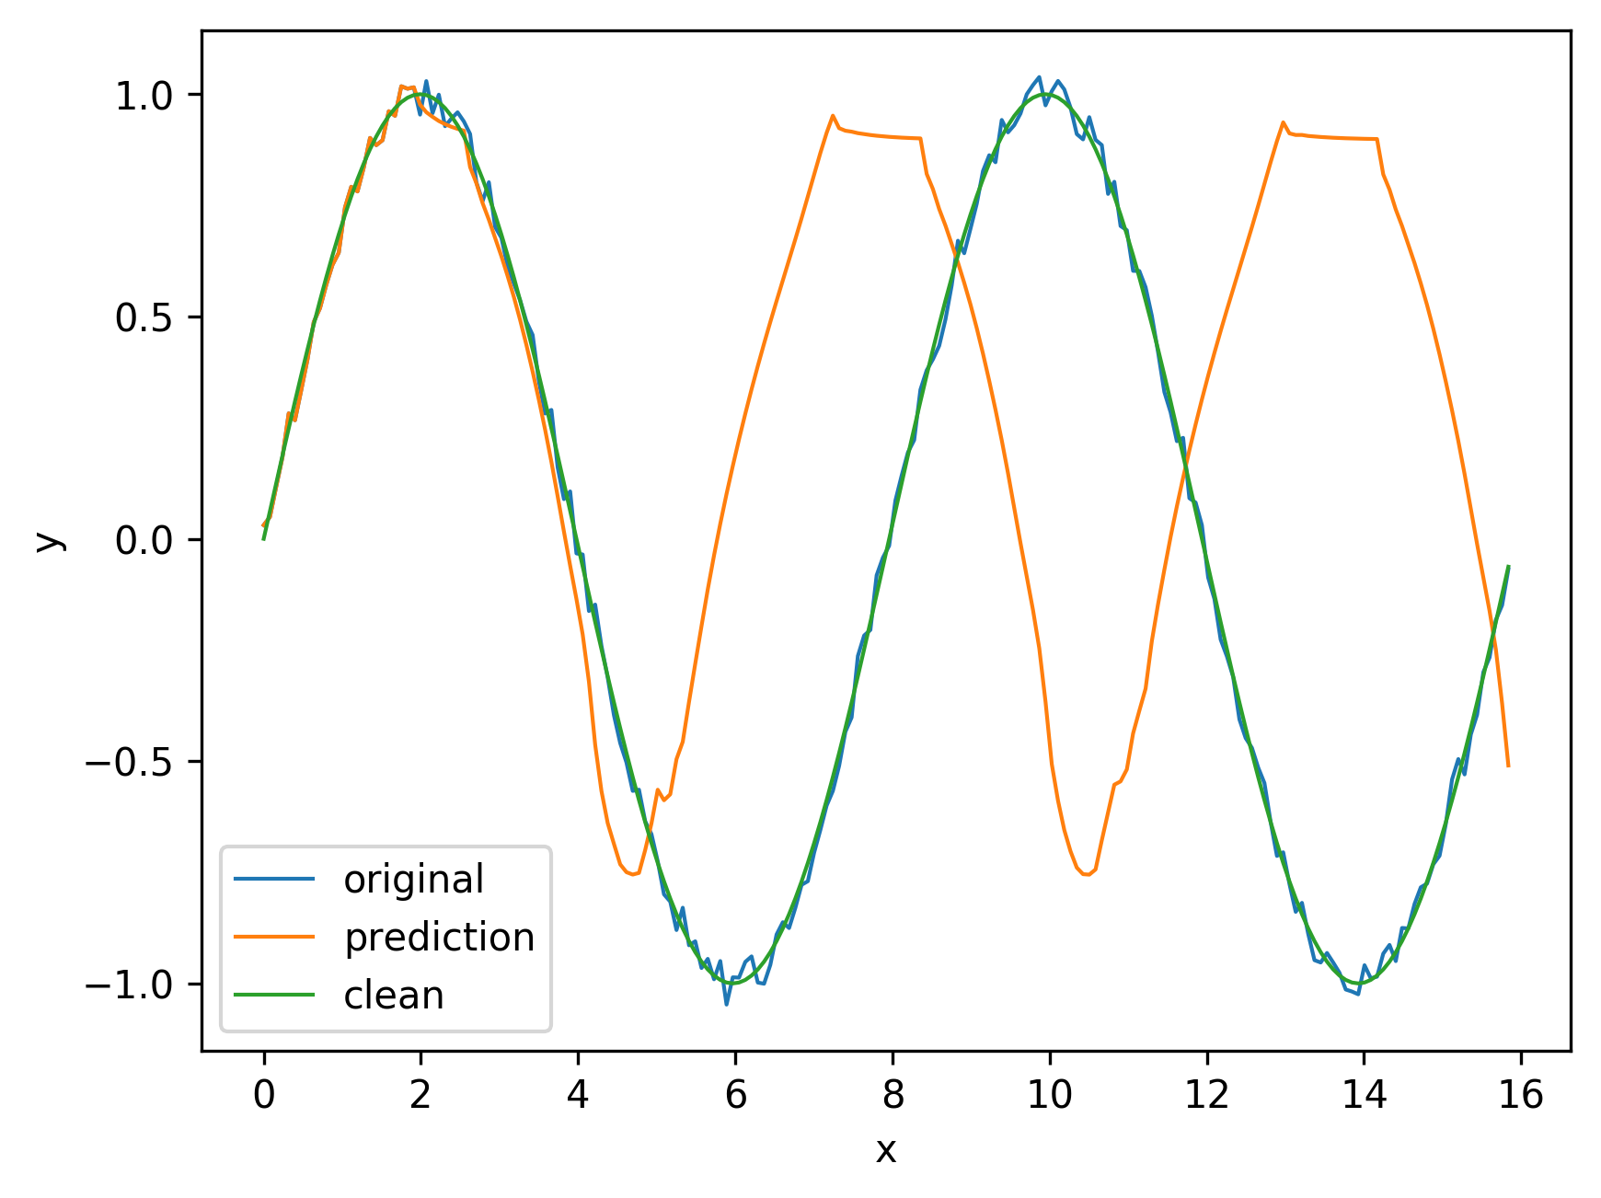
Sine wave prediction

Slide 19

Assignment
Be the sommelier!
캐글에서 제공하는 와인 리뷰 데이터를 이용하여 소믈리에처럼 와인 품평을 해봅시다!
https://www.kaggle.com/zynicide/wine-reviews
참고
https://www.kaggle.com/ankasor/fake-wine-reviews-with-keras-lstm
https://aikorea.org/blog/rnn-tutorial-2/

Slide 20
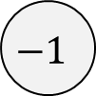


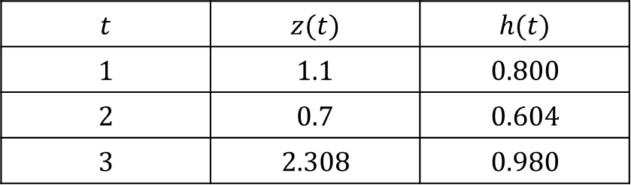

Feedforward
$$x(3)$$
$$y(3)$$
$$h(3)$$
$$1$$
$$U$$
$$V$$
$$U=1, W=2, V=3, b=0.1, c=0.2$$
$$f\left(x\right)=tanh, g\left(x\right)=x$$
$$W$$
$$x(2)$$
$$h(2)$$
$$t$$ | $$z(t)$$ | $$h(t)$$
$$1$$ | $$1.1$$ | $$0.800$$
$$2$$ | $$0.7$$ | $$0.604$$
$$3$$ | $$2.308$$ | $$0.980$$
$$−1$$
$$U$$
$$W$$
$$x(1)$$
$$h(1)$$
$$1$$
$$U$$
$$y\left(3\right)=3.14$$
$$W$$
$$h(0)$$
$$0$$

